Slide 1

Predicting Factors that impact Walmart Sales
Rupali Shah

Slide 2
Table of Contents
Overview
Data Acquisition
Data Questions
Data Exploration
Model Building
Results
Future Work

Slide 3
Overview
Walmart is an American multinational retail corporation that operates a chain of supermarkets and grocery stores.
This project predicts the features that can help increase future sales.

Slide 4
Data Acquisition
Historical sales data for Walmart outlets in different cities for the year 2013
Dataset - 8523 records, 13 features, and 1 target variable
Data source - Kaggle
https://www.kaggle.com/anshg98/walmart-sales

Slide 5
Data Questions?
Are the higher income levels of people in urban cities driving the sales of Tier 1 stores?
Do supermarkets have higher sales because customers prefer to shop most of the items from one place?
Do the older stores have better sales because of customer loyalty?
Does product visibility impact sales?
Do necessities sell more than other items?

Slide 6
Data Exploration
https://github.com/RupaliShah/Springboard/blob/master/Capstone1/EDA.ipynb

Slide 7
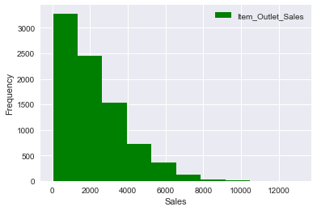
Overall Sales

Slide 8
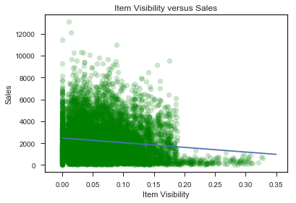
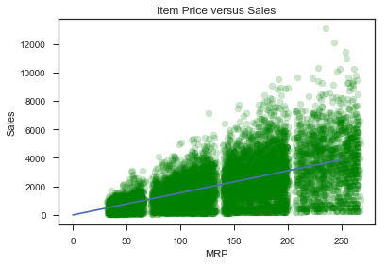
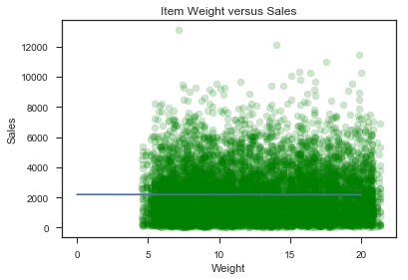
Item Visibility, Weight and MRP

Slide 9
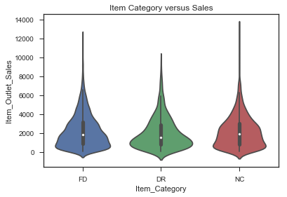
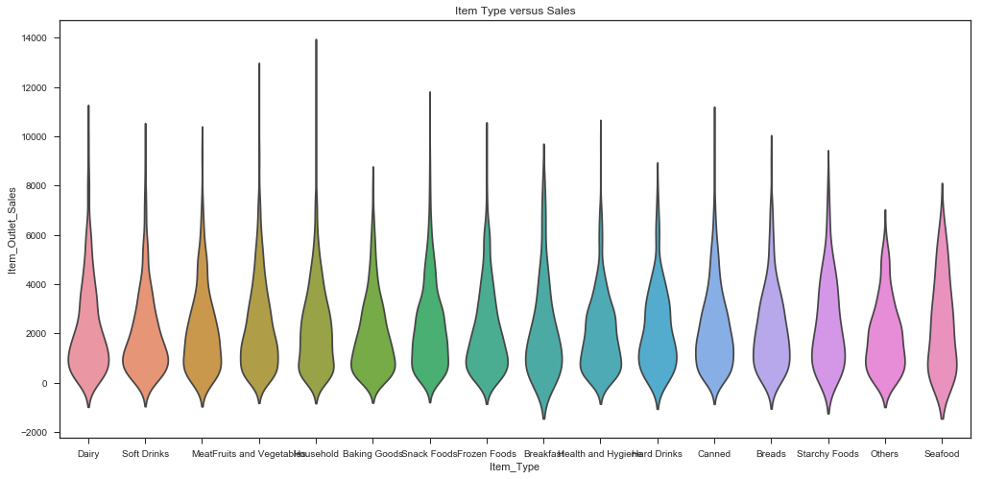
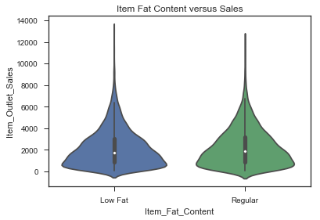
Distribution of sales across all products

Slide 10
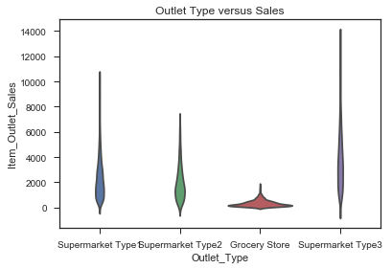
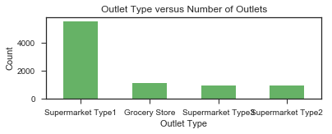
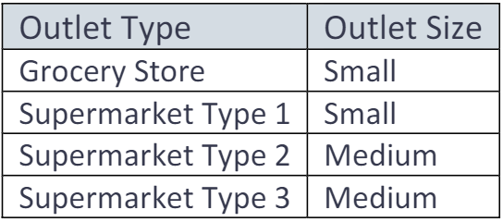
Type and size of outlets

Slide 11
Model Building
https://github.com/RupaliShah/Springboard/blob/master/Capstone1/Machine%20Learning%20Models.ipynb

Slide 12
Feature Engineering
Categorize items into three broad categories – Food, Drink, and Non-consumable.
Impute missing values of Item Weight based on weight of other similar items.
Replace missing values of Outlet Size based on the Outlet Type.
Compute Outlet Age and add as a new column.
Delete columns grouped into new features.

Slide 13
Modeling Overview
Supervised Learning Algorithms:
Linear Regression
Lasso Regression
Random Forest Regressor
Libraries:
scikit-learn
statsmodels (OLS version)

Slide 14
Modeling Steps
Evaluate data using statsmodels
Build models using scikit-learn
Data pre-processing
Label encoding
Data splitting into training and test sets (80%-20%)
Hyperparameter tuning
Randomized Search Cross Validation(CV)
Evaluation metric
r2_score
root mean squared error

Slide 15
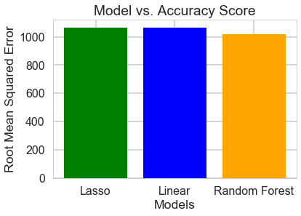
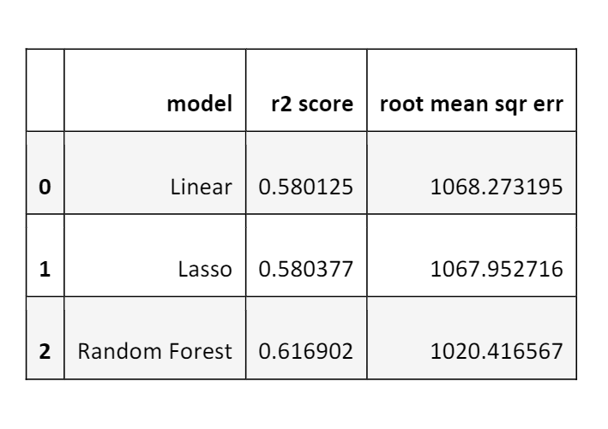
Model Comparison

Slide 16
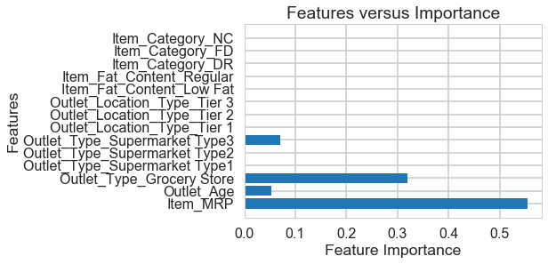
Important predictors of sales

Slide 17
Results
MRP is the most important predictor of sales followed by Supermarket Type and Outlet Age.
Older stores have customer loyalty.
Grocery Stores and Supermarkets that carry a larger variety of products can help increase future sales.
Location of the outlets does not impact sales.
Item Visibility has no impact on sales.

Slide 18
Future work
Other models such as XGBoost can be tested.
Models can be tested with a different subset of features.
Outliers can be removed to reduce skewness and to improve model performance.

Slide 19
Thank you!

